Slide 1
EUCALYPTUS:
An Elastic Utility Computing Architecture for Linking Your Programs to Useful Systems

Slide 2
Eucalyptus is an open source software to build private and hybrid cloud in Amazon Web Services (AWS).
It’s the world’s most widely deployed s/w platform for on premise IaaS clouds.

Slide 3
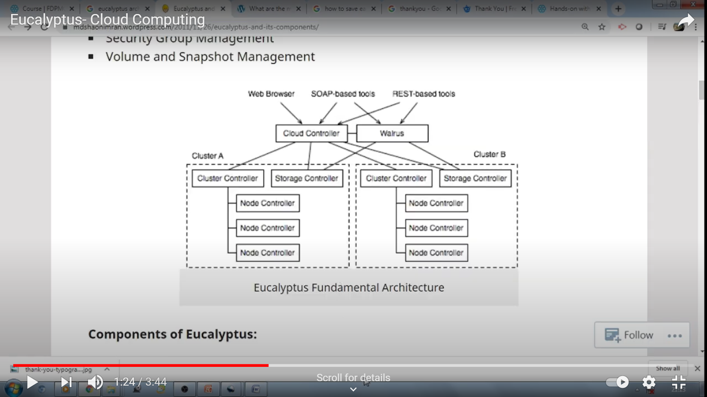
Eucalyptus Architecture

Slide 4
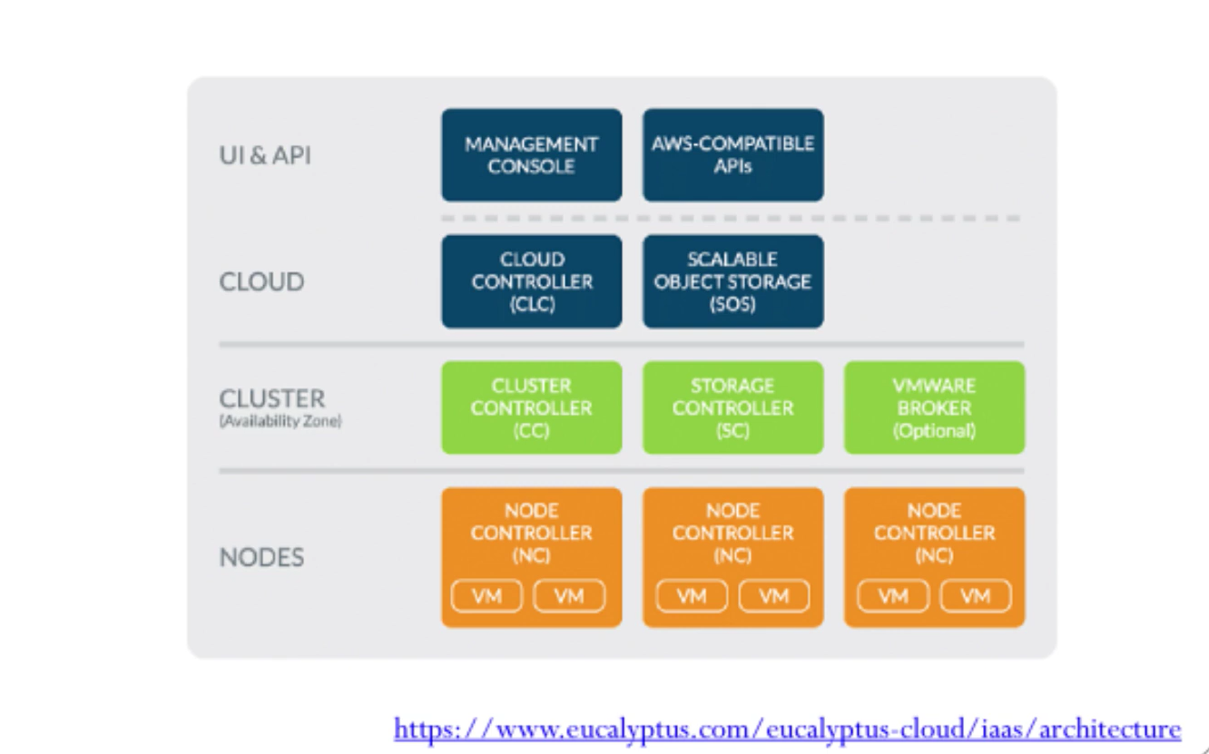

Slide 5
Five Main components of E ucalyptus cloud architecture
Cloud Controller (CLC): This is a controller that manages virtual resources like servers, network and storage . It is at the highest level in the hierarchy. It is a java program with web interface for outside world . It can do resource scheduling as well as system accounting . There is only one CLE per cloud. It can handle authentication ,accounting ,reporting in cloud

Slide 6
Walrus : This is another java program in eucalyptus that is equivalent to AWS S3 storage . It provides persistent storage . It also contains images , volumes and snap-shots similar to AWS .There is only one walrus in the cloud.

Slide 7
Cluster controller (CC) : It is a C program that is the front end of the eucalyptus cloud cluster .It can communicate with storage controller and node controller.It manages instance execution in the cloud.

Slide 8
Storage Controller (SC) : It is a java program equivalent to EBS in AWS . It can interface with cluster controller and node controller to manage persistent data via Walrus

Slide 9
Node Controller (NC) : It is a C program that host a virtual machine instance .It is at the lowest level in eucalyptus cloud .It downloads images from walrus and creates an instance for computing requirements in cloud .Manages life cycle of an instance .

Slide 10
Services provided by Eucalyptus:
Network Isolation : It is the vital part in any layered security approach. It is user by all players from small businesses to large organizations
Elastic IP’s: An elastic IP address is a static IPv4 address designed for dynamic cloud computing . It is associated with your AWS account.
Security Groups : Security groups are used to collect user accounts, computer accounts and other groups into manageable units.
Meta Data Services: Meta data catalog service in the cloud is a mechanism for storing and accessing descriptive metadata and allow cloud users to query for data items based on desired attributes.

Slide 11
Thank You!!!!!!

